Slide 1

Practising Further Revision Techniques

Slide 2
Y11 Mantra
“Be selfish for my grade”

Slide 3
Do Now
On a MWB, answer the following questions then discuss with your tutor.
What were the four retrieval activities that you used to revise in
Last week’s session?
What was your favourite one and why?
Which one did you find the least helpful and why?
What would you still like to know more about when it comes to revision?

Slide 4
Aims of Today’s Session
By the end of today’s revision session, you will have:
Practised the Leitner Flashcard revision method.
Practised the Cornell Notes revision method.
Planned out a revision schedule for the first two weeks of this half term.
Chosen a different revision method for each revision slot on your new two week schedule.

Slide 5
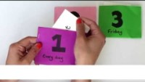
Leitner Flashcard Method

Slide 6
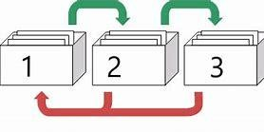
Leitner Flashcard Method

Slide 7
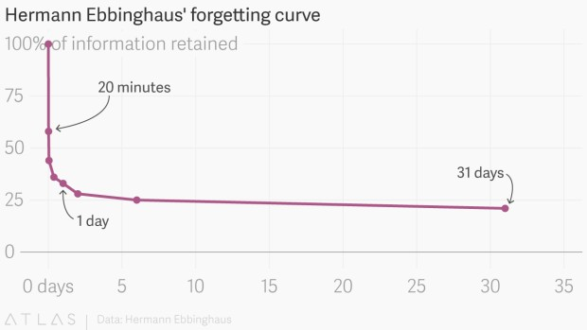
Leitner Flashcard Method

Slide 8
Leitner Flashcard Method
How to make effective flashcards
Lots of people make the mistake and do not create effective flashcards. Here are some simple tips so you can avoid these common mistakes:
Make your own flashcards.
One question and one answer per card.
Use pictures/diagrams and words.
Use mnemonic devices.

Slide 9
Leitner Flashcard Method
BOX 1
Every day
BOX 2
Tuesday & Thursday
BOX 3
Friday

Slide 10
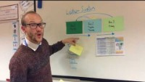
Leitner Flashcard Method

Slide 11
Leitner Flashcard Method
I answered a flashcard correctly from Box 1. Where do I put it now?
I answered a flashcard incorrectly from Box 1. Where do I put it now?
I answered a flashcard correctly from Box 2. Where do I put it now?
I answered a flashcard incorrectly
from Box 2. Where do I put it now?
I answered a flashcard correctly from Box 3. Where do I put it now?
I answered a flashcard incorrectly
from Box 3. Where do I put it now?
Box 2
Box 1
Box 3
Box 1
Box 3
Box 1

Slide 12
Leitner Flashcard Method
BOX 3: Friday
BOX 2:
Tuesday &
Thursday
BOX 1: Every day

Slide 13
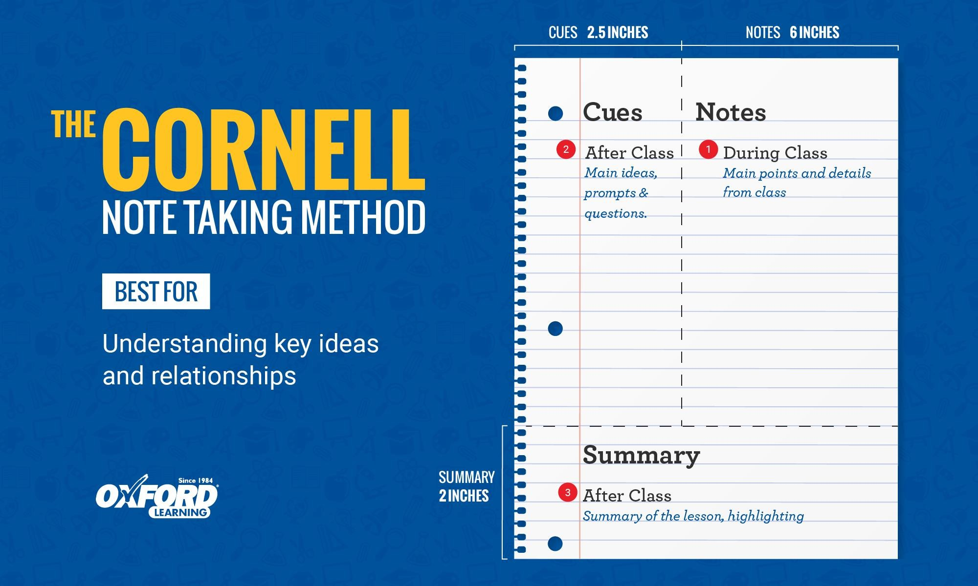
Cornell Notes Method

Slide 14

Cornell Notes Method

Slide 15
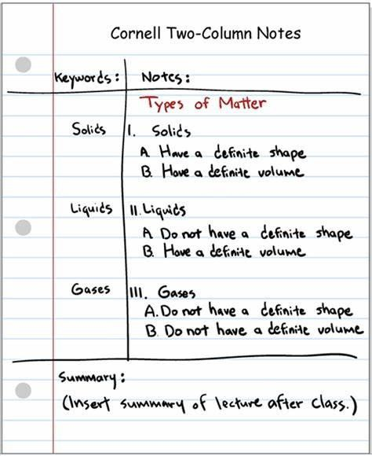
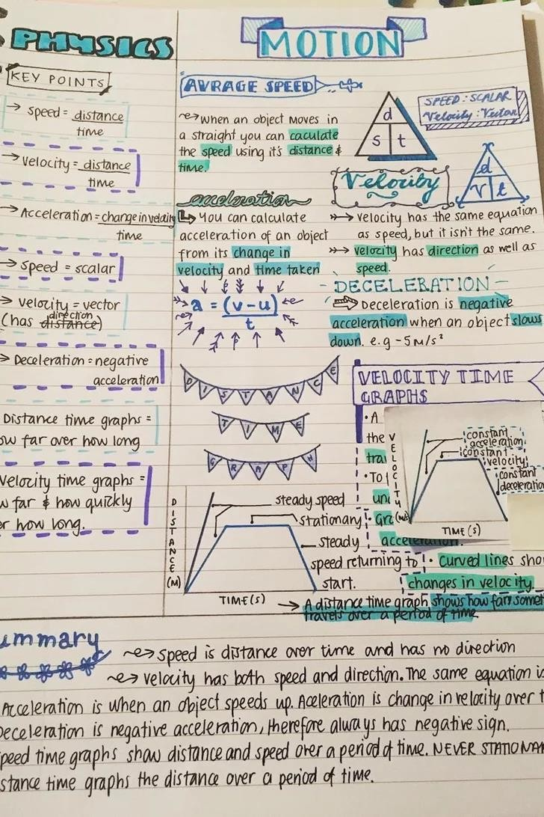
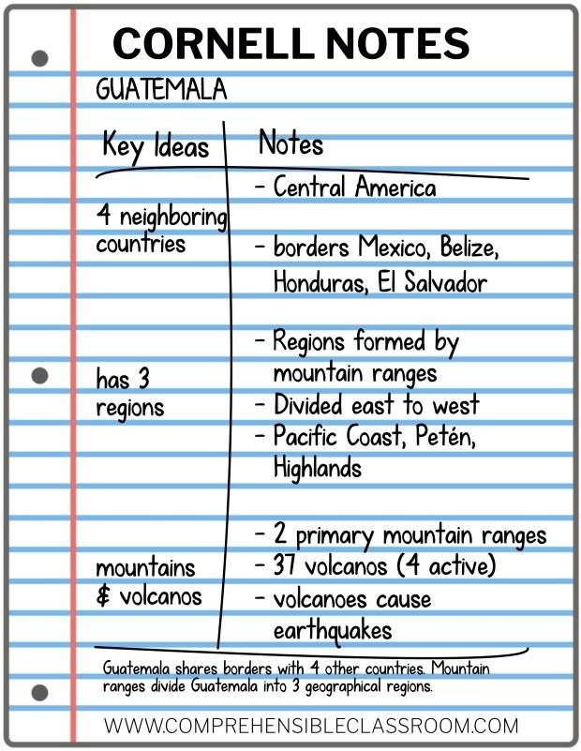
Cornell Notes Method

Slide 16
Cornell Notes Method
There are many different ways of taking notes in school or at the university. Some prefer to take a structured approach and use an outline method to take notes, some may prefer a visual way and draw mind maps, some may even use no structure at all. However, there is one note-taking technique that is superior to others in many cases and science has proven that it is not only more efficient but also makes it a lot easier to review notes, for example when preparing for an exam.
The technique we‘re referring to is called “Cornell Note Taking”. It is a system for taking, organizing and reviewing notes and has been devised by Prof. Walter Pauk of Cornell University in the 1950s.
How to Take Cornell Notes
It requires very little preparation which makes it ideal for note taking in class. The page will be divided into 4 — or sometimes
only 3 — different sections: Two columns, one area at the bottom of the page, and one smaller area at the top of the page. The idea behind this is very easy. All actual notes from the lecture go into the main note-taking column.
The smaller column on the left side is for questions about the notes that can be answered when reviewing and keywords or comments that make the whole reviewing and exam preparation process easier.
When reviewing the notes, a brief summary of every page should be written into the section at the bottom.
Besides being a very efficient way of taking great notes in class, Cornell note taking is THE perfect tip for exam preparation.
Here’s why:
The system itself encourages you to reflect on your notes by actively summarizing them in their own words. Often, this can
already be enough to remember study notes and to successfully pass an exam.

Slide 17
Planning your Revision Schedule
 | MON A | TUES A | WEDS A | THURS A | FRI A
SUBJECT | English | Maths | Science
FOCUS
 | MON B | TUES B | WEDS B | THURS B | FRI B
SUBJECT | English | Maths | Science
FOCUS

Slide 18
Summary
In summary then, today we have:
Practised the Leitner Flashcard revision method.
Practised the Cornell Notes revision method.
Planned out a revision schedule for the first two weeks of this term.
Selected a different revision method to use for each revision slot on your revision schedule over the next two weeks.

Slide 19
Y11 Mantra
“Be selfish for my grade”

